Slide 1
Chapter 1
Introduction

Slide 2
Uses of Computer Networks
Computer network
Large number of separate but interconnected computers do a job
Collection of interconnected, autonomous computing devices
Interconnected computers can exchange information
Example: the Internet
Network uses
Access to information
Person-to-person communication
Electronic commerce
Entertainment
The Internet of Things
Notes:
计算机网络是啥
互联网
用途

Slide 3
Access to Information (1 of 4)
Web browser and smart phones retrieve information from various Web sites
Social media platforms support targeted behavioral advertising
Online digital libraries and retail sites host digital content
Client-server model forms the basis of network usage
Web applications: Server generates Web pages in response to client requests
Peer-to-peer communication: Individuals form a loose group to communicate with others in the group

Slide 4
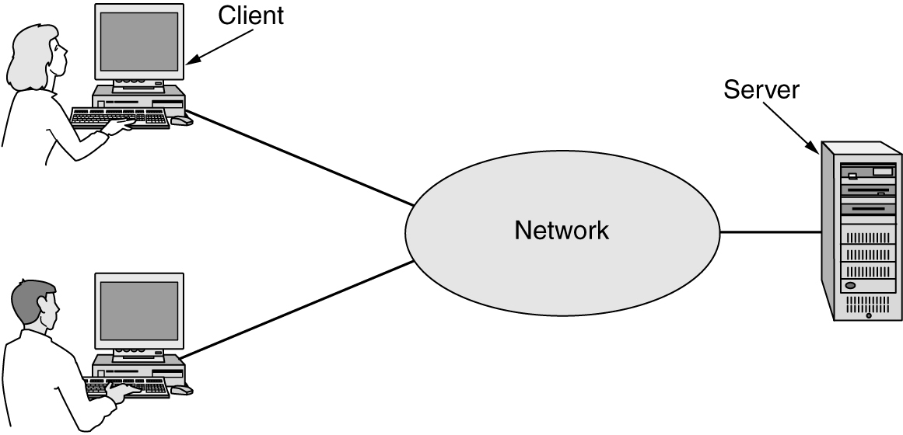
Access to Information (2 of 4)
In the client-server model, a client explicitly requests information from a server that hosts that information.

Slide 5
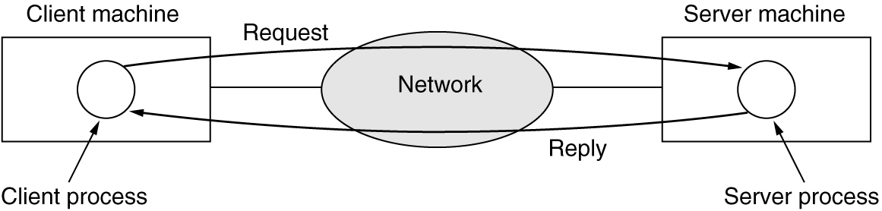
Access to Information (3 of 4)
Communication takes the form of the client process sending a message over the network to the server process. The client process then waits for a reply message.

Slide 6
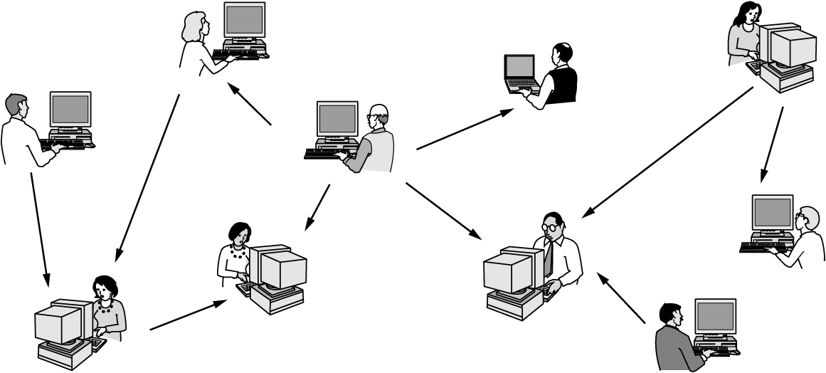
Access to Information (4 of 4)
In a peer-to-peer system, there are no fixed clients and servers.

Slide 7
Person-to-Person Communication
Instant messaging
Allows two people to type messages at each other in real time
Twitter multi-person messaging service
Allows people to send short messages to their circle of friends or other followers or the whole world
Social network applications
Information flow driven by the relationships that people declare between each other
Wiki content is a collaborative Web site the members of a community edit

Slide 8
Electronic Commerce (1 of 2)
Online shopping and financial institution transactions follow client-server model
Online auctions follow peer-to-peer model
Consumers act as buyers and sellers
Central server holds the database of products for sale

Slide 9
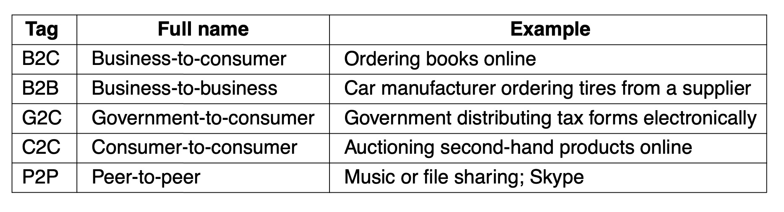
Electronic Commerce (2 of 2)
Some forms of e-commerce have acquired little tags based on the fact that ‘‘to’’ and ‘‘2’’ are pronounced the same.

Slide 10
Entertainment
IPTV (IP Television) systems
TV shows based on IP technology instead of cable TV or radio transmissions
Media streaming applications
Internet-provided radio stations, TV shows, and movies
Content usually moves wirelessly between devices
Game playing using multi-person real-time simulation
Virtual worlds provide a persistent setting
Thousands of users experience a shared reality with three-dimensional graphics

Slide 11
The Internet of Things
Ubiquitous computing
Computing embedded in everyday life
Home security systems wired with door and window sensors
Sensors folded into a smart home monitor
Smart refrigerators
IoT (Internet of Things)
Sensing and communication take place over the Internet
Poised to connect every electronic device to the Internet
Power-line networks
Send information throughout the house over the electric wires

Slide 12
Types of Computer Networks
Mobile and broadband access networks
Networks used to access the Internet
Data-center networks
Networks that house data and applications
Transit networks
Networks that connect access networks to data centers
Enterprise networks
Networks used on campuses, in office buildings, or at other organizations

Slide 13
Broadband Access Networks
Home network use
Listen to, look at, and create music, photos, and videos
Access information, communicate with other people, buy products and services
Metcalfe’s law
Explains how tremendous Internet popularity comes from its size
Broadband access networks
Delivered to homes using copper, coaxial cable, or optical fiber
Broadband Internet speeds: gigabit per second to individual homes
Notes:
梅特卡夫定律（英語：Metcalfe‘s law）是一个关于网络的价值和网络技术的发展的定律，由喬治·吉爾德於1993年提出，但以计算机网络先驱、3Com公司的创始人罗伯特·梅特卡夫的姓氏命名，以表彰他在以太网络上的貢獻。其内容是：一个网络的价值等于该网络内的节点数的平方，而且该网络的价值与联网的用户数的平方成正比。
该定律指出，一个网络的用户数目越多，那么整个网络和该网络内的每台电脑的价值也就越大。
在数据结构中,N个顶点的连通图 至少要有（N-1）条边（也就是树）才能保证图为连通图. 对于简单图而言至多有n* (n-1)/2条边,此时即是完全图. 强连通图最多n (n-1)条边,最少n-1条边.

Slide 14
Mobile and Wireless Access Networks (1 of 3)
Wireless hotspots are based on the 802.11 standard
Wireless networking and mobile computing
Related but not identical
Smartphones combine aspects of mobile phones and mobile computers
Text messaging or texting short message
GPS (Global Positioning System): locates a device
Geo-tagging: annotating photos and videos with the location where they were made
Notes:
802.11 无线局域网标准
无线网络关注网，移动计算关注算
手机：智能终端设备的代表，集移动的通信终端和计算终端于一身

Slide 15
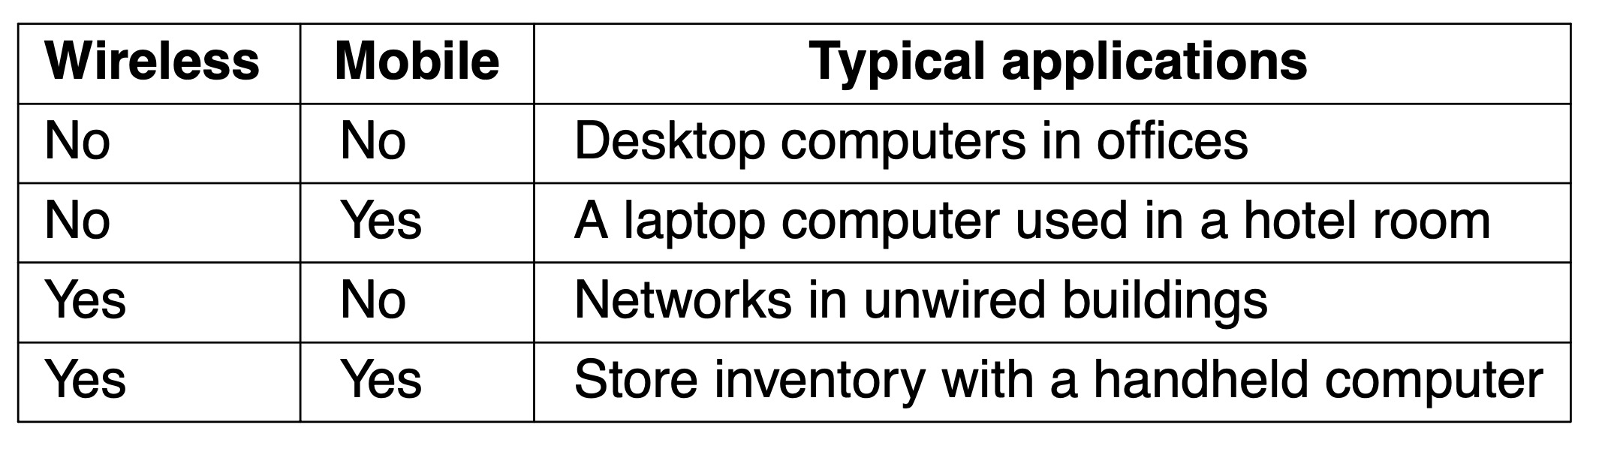
Mobile and Wireless Access Networks (2 of 3)
Although wireless networking and mobile computing are often related, they are not identical.
Notes:
第二项是指用网线的case？

Slide 16
Mobile and Wireless Access Networks (3 of 3)
M-commerce (mobile-commerce) uses mobile phones
NFC (Near Field Communication)
Allows mobile device to act as an RFID smartcard and interact with a nearby reader for payment
Sensor networks use nodes gathering and relaying information about the physical state of the world
Nodes may be embedded in familiar devices (cars or phones)
Nodes may be small, separate devices
Provide a wealth of data on behavior
Example: wireless parking meters

Slide 17
Content Provider Networks
Data-center network
Internet services are served from ‘‘the cloud’’
Serves the increasingly growing demands of cloud computing
Moves large amounts of data between servers in the data center
Moves data between the data center and the rest of the Internet
Data center network challenges
Network throughput and energy usage scaling
‘‘Cross-section bandwidth”
CDN (Content Delivery Network)
Large collection of servers, geographically distributed so content is close to the users requesting it
Notes:
内容提供商，
数据中心，伴云而生
挑战——可拓展性：吞吐量，能耗；
“cross-section bandwidth” is the data rate that can be delivered between any two servers in the network.
The maximum cross-sectional bandwidth is defined as the bidirectional data rate that can pass between two parts of the network if it is divided into two equal halves.
CDN：Akamai Cloudflare
典型任务，确定向用户提供CDN中的哪个副本，需考虑 距离，服务器负载，链路负载，网络拥塞程度等。

Slide 18
Transit Networks
Transit network
Carry traffic between the content provider and the ISP (Internet Service Provider) when they are not directly connected
Typically charge both the ISP and the content provider for carrying traffic from end-to-end
Traditionally called backbone networks because they carry traffic between two endpoints
Two trends
Consolidation of content in a handful of large content providers
Expansion of the footprint of individual access ISP networks
Notes:
转接网络？
两个趋势：内容集聚在大的提供商手里，因为云服务和大型内容分发网络的流行。
ISP覆盖范围的扩大。很多ISP变成国家级甚至是洲际的。因为这个趋势，对转接网络的依赖度降低了。

Slide 19
Enterprise Networks
Allows resource sharing for devices and information
VPNs (Virtual Private Networks)
Connect individual networks at different sites into one logical network
Act as a communication medium among employees
Allows IP telephony or VoIP (Voice over IP)
Internet technology and computer networks for telephone calls
Allows desktop sharing
Remote workers can see and interact with a computer screen
Allows electronic business communication
Notes:
虚拟专用网

Slide 20
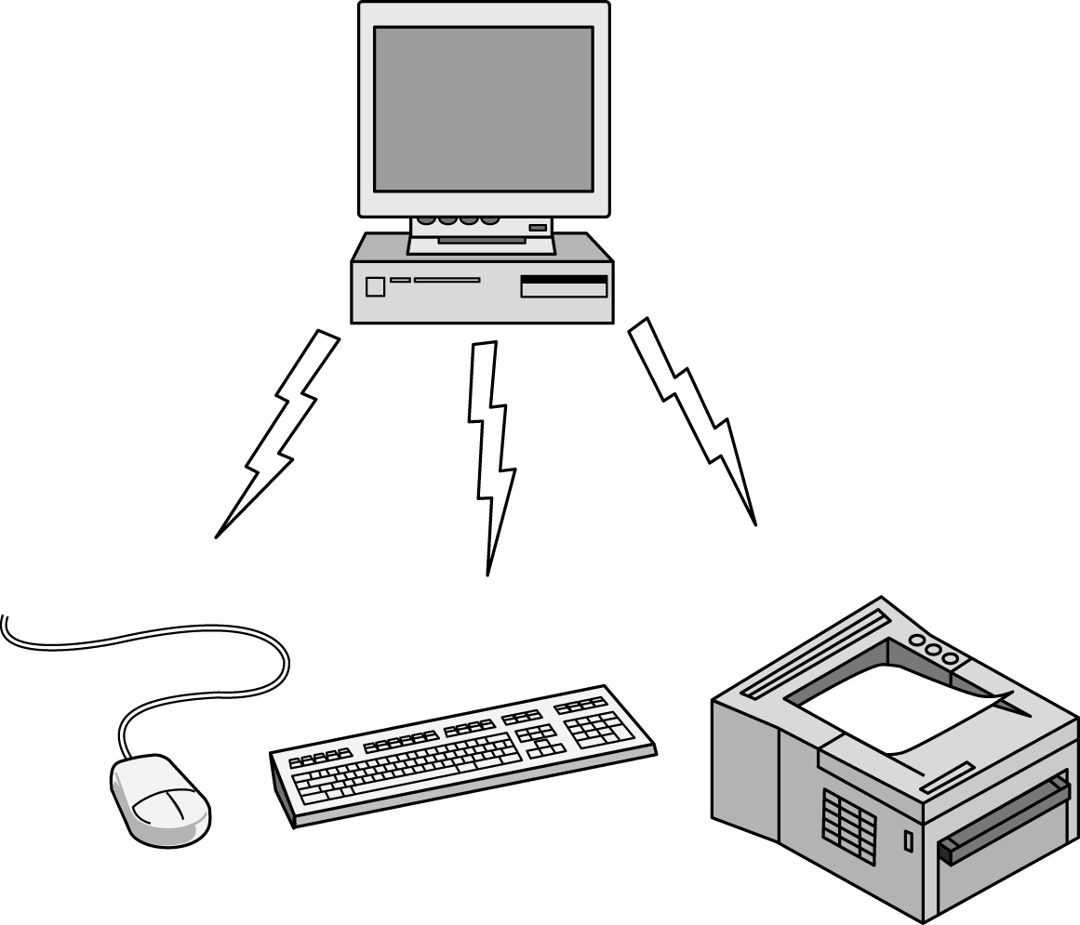
Personal Area Networks
PANs (Personal Area Networks) let devices communicate over the range of a person. Bluetooth is a short-range wireless network used to connect components without wires.

Slide 21
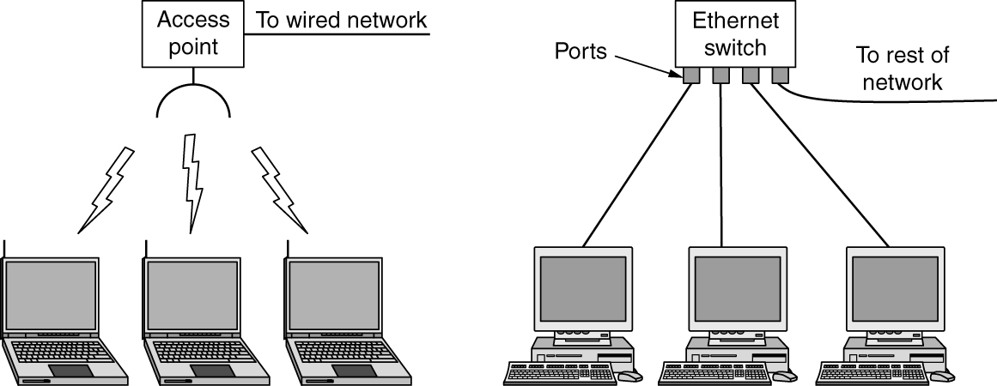
Local Area Networks
The configuration on the left represents a wireless 802.11 network. The configuration on the right represents a wired switched Ethernet network.
Notes:
无线局域网 标准802.11
Access Point AP/ Wireless router/ base station
Mesh network
以太网，switch 交换机，port，
The job of the switch is to
relay packets between computers that are attached to it, using the
address in each packet to determine which computer to send it to.

Slide 22
Home Networks
Home network LAN
Broad, diverse range of Internet-connected devices
Characteristics: manageable, dependable, and secure
Internet of things
Allows almost any device to connect
Required home network properties
Easy to install
Secure and reliable
Interfaces work between all products
Reduced consumer device costs
Notes:
Powerline network

Slide 23
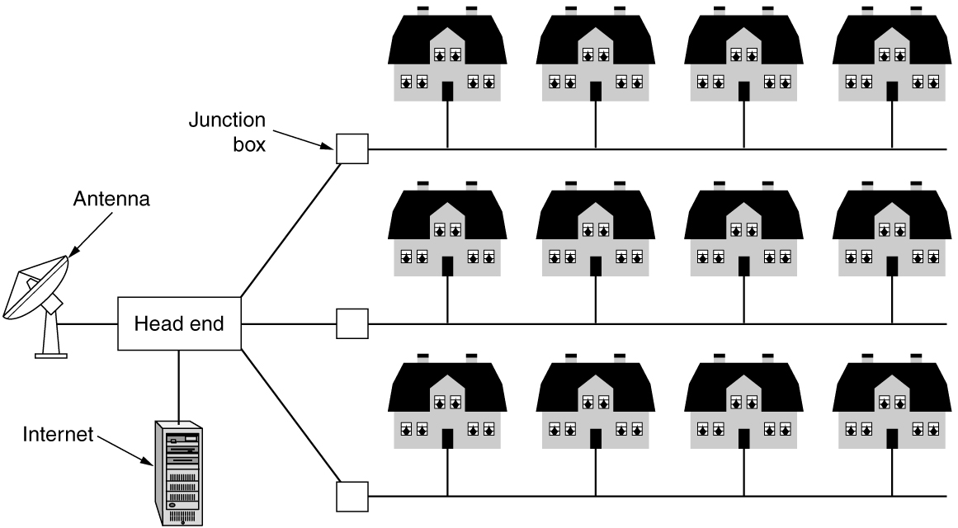
Metropolitan Area Networks
A MAN (metropolitan area network) where both television signals and the Internet are being fed into the centralized cable head-end (or cable modem termination system) for subsequent distribution to people’s homes.
Notes:
城际网
同轴电缆
无线形式：WiMAX LTE 5G

Slide 24
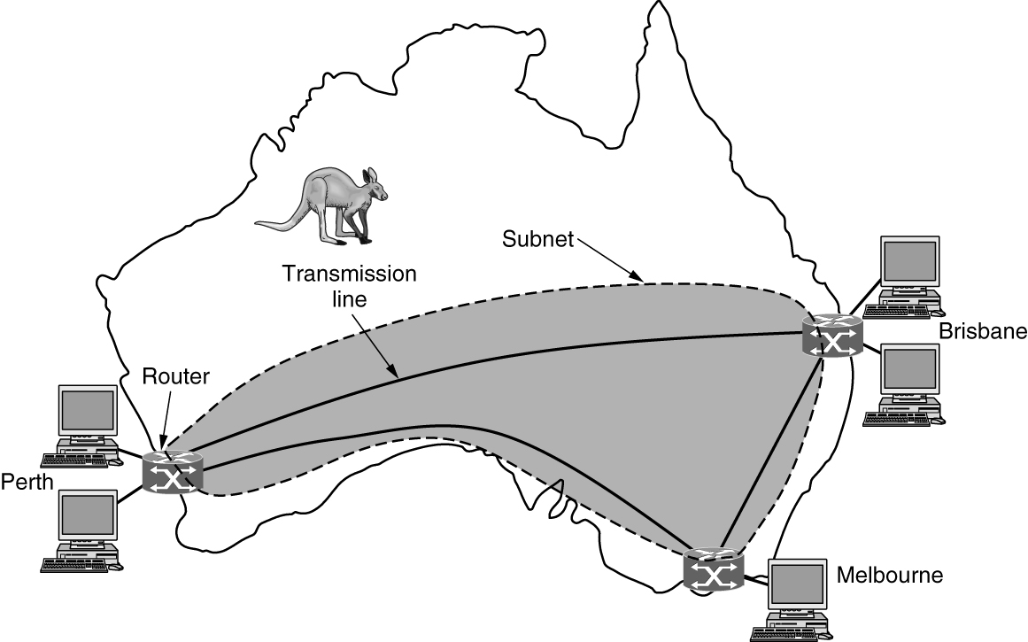
Wide Area Networks (1 of 3)
This wide area network illustrates how hosts in Perth, Brisbane, and Melbourne can communicate using leased lines.
Notes:
广域网
Transmission line and switching elements
How the network makes the decision as to which path to use is called a routing
algorithm.
How each router makes the decision as to where to send a
packet next is called a forwarding algorithm

Slide 25
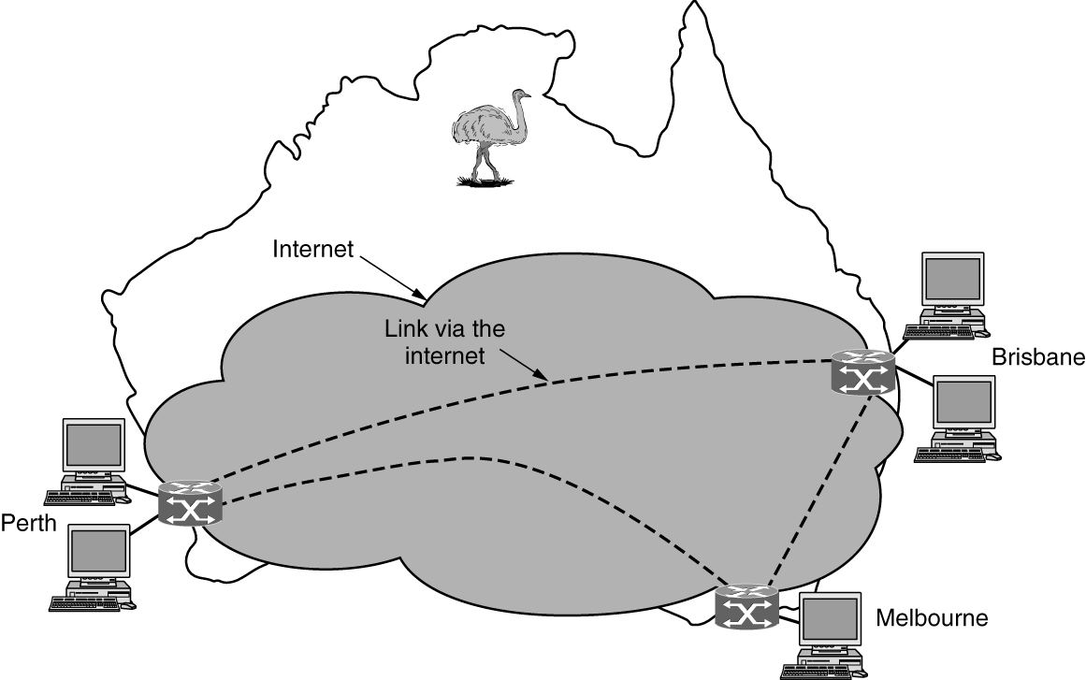
Wide Area Networks (2 of 3)
This wide area network illustrates how hosts in Perth, Brisbane, and Melbourne can communicate via the Internet.
Notes:
By using Internet connectivity instead of leasing dedicated transmission lines to connect offices, the wide area network (WAN) connections can be made between the offices as virtual links using the underlying capacity of the Internet.

Slide 26
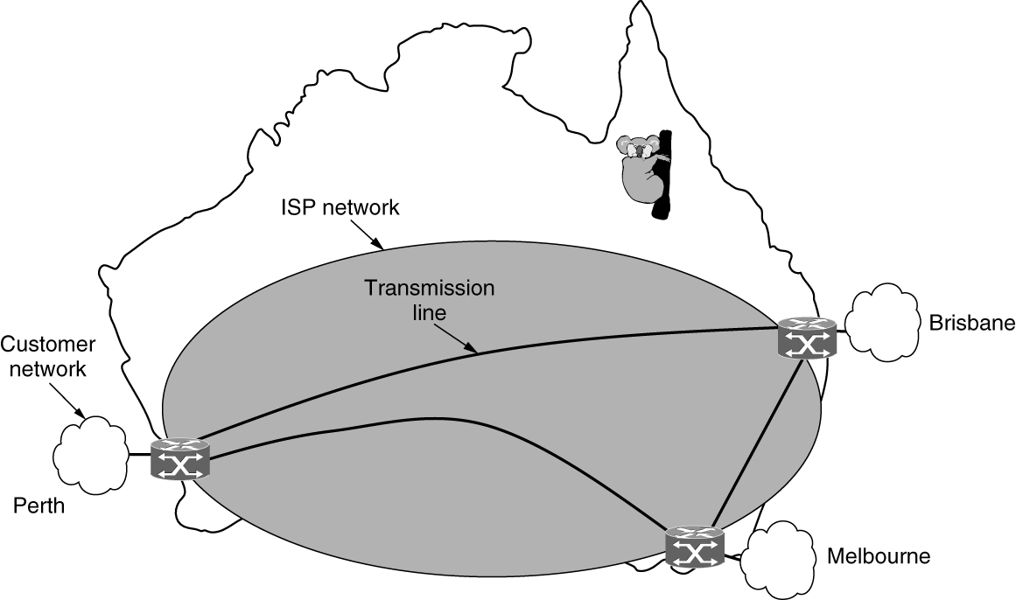
Wide Area Networks (3 of 3)
This wide area network illustrates how hosts in Perth, Brisbane, and Melbourne can communicate via an ISP.
Notes:
By using a network that is operated by a commercial Internet service provider (ISP), the wide area network (WAN) connections can be made between the offices. This type of set-up may help reduce performance degradation issues that may be seen when connecting over the Internet.
organizations that are distributed across geographic
regions and need to connect sites are designing and deploying socalled
software-defined WANs or SD-WANs, which use different,
complementary technologies to connect disjoint sites but provide a
single SLA (Service-Level Agreement) across the network.
SDN (Software-Defined Network),

Slide 27
Internetworks
Internetwork or internet
A collection of interconnected networks
Network combines subnets and hosts
Subnet can be described as a ISP network (Figure 1-11)
Internetwork might be described as a WAN network (Figure 1-9)
An internet
Interconnection of distinct, independently operated networks
Connecting a LAN and a WAN or connecting two LANs
Gateway device makes a connection between two or more networks
Notes:
互连网，不是互联网

Slide 28
Examples of Networks (1 of 9)
The Internet
The ARPANET
NSFNET
The Internet architecture
Mobile networks
Mobile network architecture
Packet switching and circuit switching
Early generation mobile networks: 1G, 2G, and 3G
Modern mobile networks: 4G and 5G
Wireless networks (WiFi)
Notes:
互联网
阿帕网

Slide 29
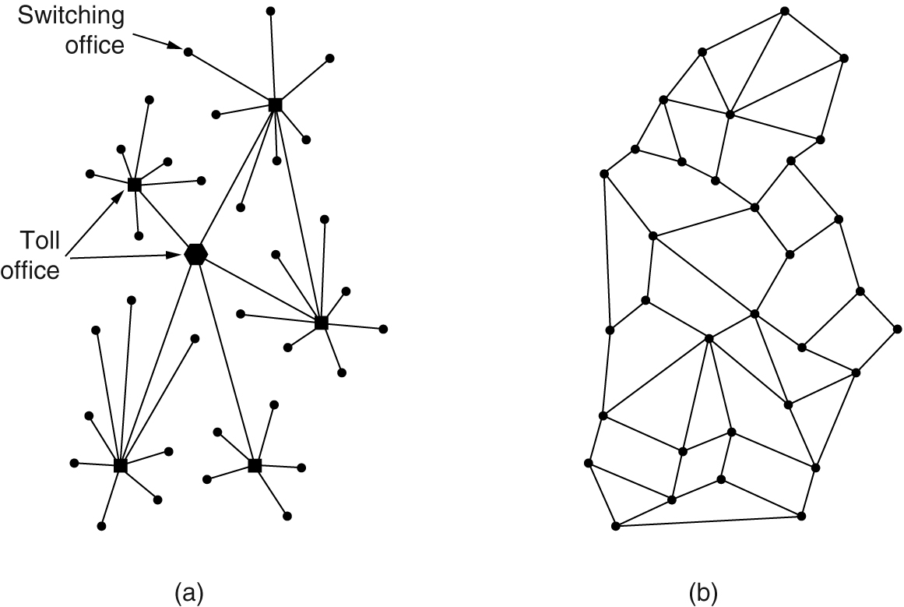
Examples of Networks (2 of 9)
Figure (a) represents an unsecure network with little redundancy. Figure (b) illustrates a more secure packet-switched network that was initially dismissed as a solution.

Slide 30
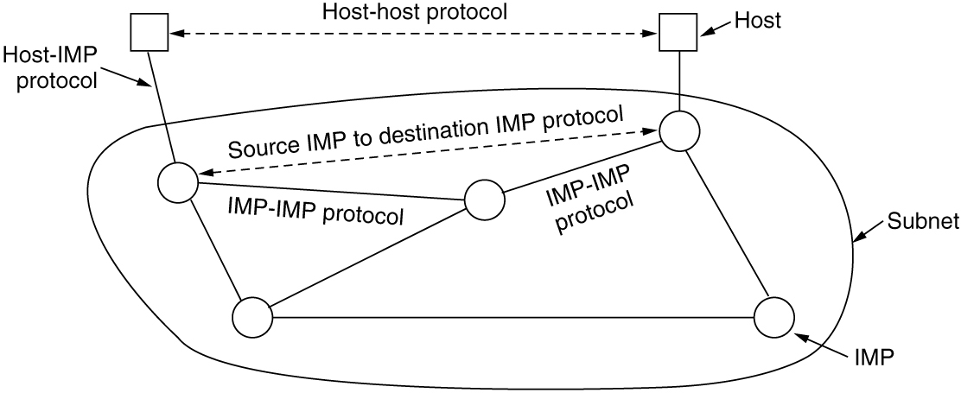
Examples of Networks (3 of 9)
The original ARPANET software was split into two parts: subnet and host. The subnet software consisted of the IMP end of the host-IMP connection, the IMP-IMP protocol, and a source IMP to destination IMP protocol designed to improve reliability.

Slide 31
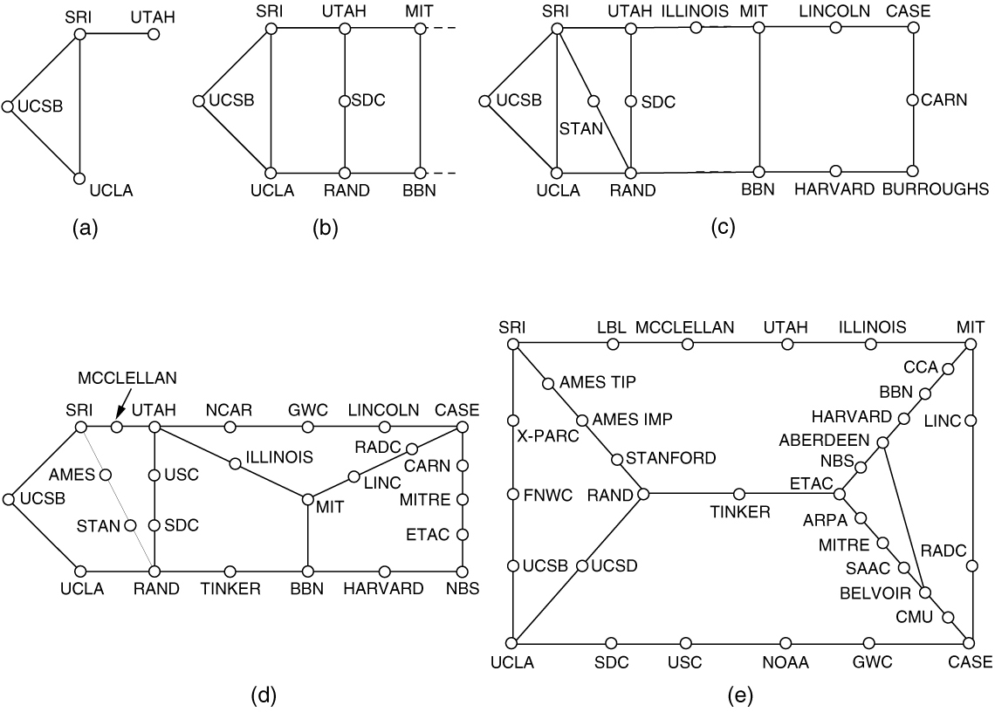
Examples of Networks (4 of 9)
Growth of the number of nodes on ARPANET. (a) December 1969. (b) July 1970. (c) March 1971. (d) April 1972. (e) September 1972.

Slide 32
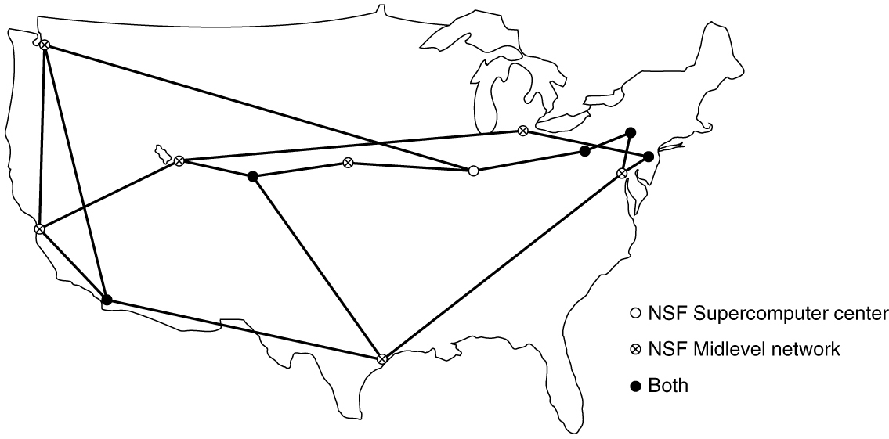
Examples of Networks (5 of 9)
NSFNET was a backbone network designed to be a successor to the ARPANET that would be open to all university research groups, allowing them to communicate without having to contract with the Department of Defense.

Slide 33
Examples of Networks (6 of 9)
Cable television infrastructure connects to the Internet
HFC (Hybrid Fiber-Coaxial) network is a single integrated infrastructure
Uses packet-based transport called DOCSIS (Data Over Cable Service Interface Specification)
DOCSIS transmits a variety of data services, including television channels, high-speed data, and voice
Device at the home end is called a cable modem
Device at the cable headend is called the CMTS (Cable Modem Termination System)
Modem is short for “modulator demodulator”

Slide 34
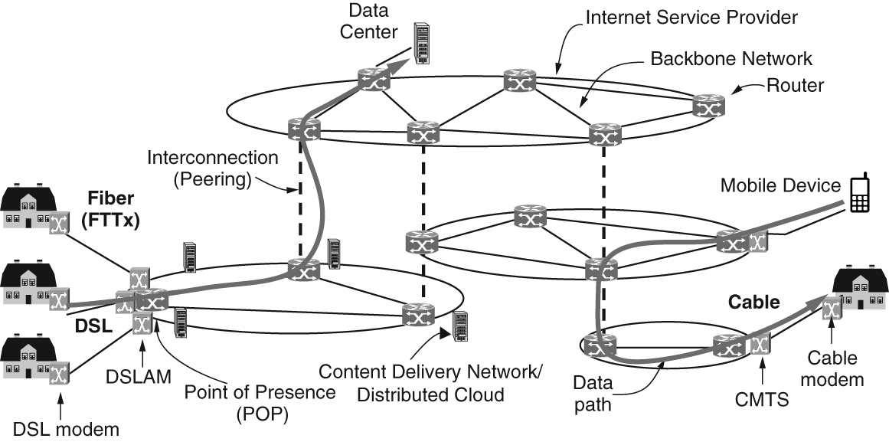
Examples of Networks (7 of 9)
A common method for connecting to the Internet from your home is to send
signals over the cable television infrastructure.

Slide 35
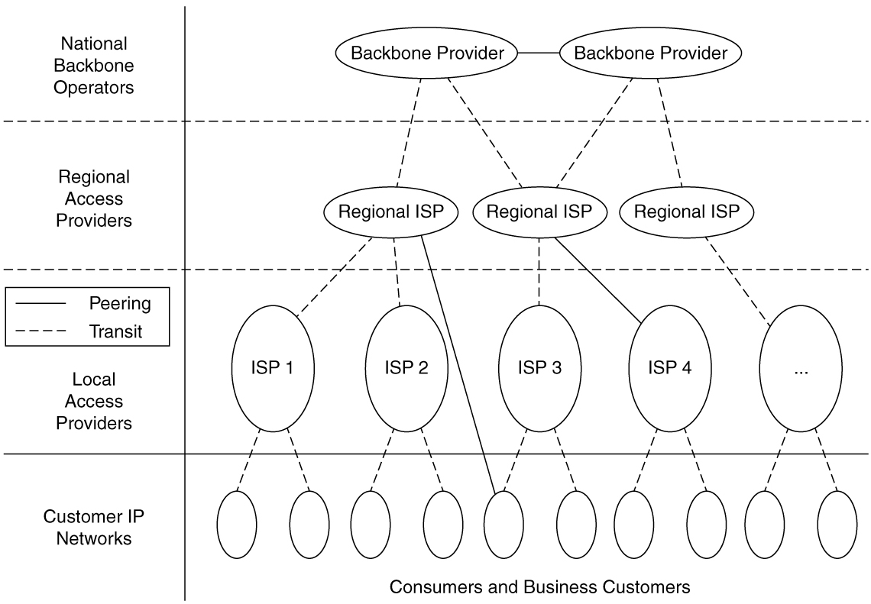
Examples of Networks (8 of 9)
Conventionally, the Internet architecture has been viewed as a hierarchy, with
the tier-1 providers at the top of the hierarchy and other networks further down the
hierarchy, depending on whether they are large regional networks or smaller access
networks.

Slide 36
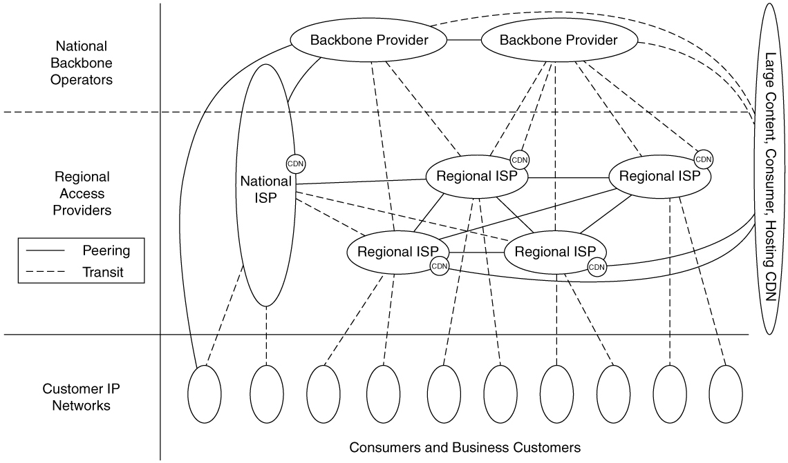
Examples of Networks (9 of 9)
Over the past decade, the conventional hierarchy has evolved and ‘‘flattened’’ dramatically.

Slide 37
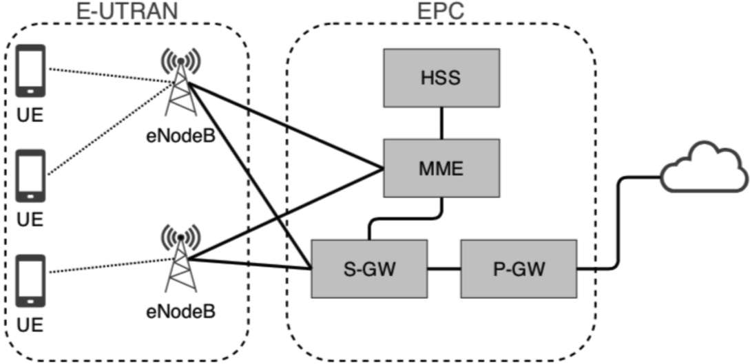
Mobile Networks (1 of 6)
The architecture of the mobile phone network has several parts.
Notes:
First, there is the E-UTRAN (Evolved UMTS Terrestrial Radio
Access network) which is a fancy name for the radio communication
protocol that is used over the air between the mobile device (e.g., the
cell phone) and the cellular base station, which is now called an
eNodeB. UMTS (Universal Mobile Telecommunications System) is
the formal name for the cellular phone network. Advances in the air
interface over the past decades have greatly increased wireless data
rates (and are still increasing them). The air interface is based on
CDMA (Code Division Multiple Access),
The cellular base station together with its controller forms the radio
access network. This part is the wireless side of the mobile phone
network. The controller node or RNC (Radio Network Controller)
controls how the spectrum is used. The base station implements the
air interface.
The rest of the mobile phone network carries the traffic for the radio
access network. It is called the core network. In 4G networks, the
core network became packet-switched, and is now called the EPC
(Evolved Packet Core). The 3G UMTS core network evolved from
the core network used for the 2G GSM system that came before it; the
4G EPC completed the transition to a fully packet-switched core
network. The 5G system is also fully digital, too. There is no going
back now. Analog is as dead as the dodo.
Data services have become a much more important part of the mobile
phone network than they used to be, starting with text messaging and
early packet data services such as GPRS (General Packet Radio
Service) in the GSM system. These older data services ran at tens of
kbps, but users wanted even higher speeds.. Newer mobile phone
networks support rates of multiple Mbps. For comparison, a voice call
is carried at a nominal rate of 64 kbps, typically 3–4x less with
compression.

Slide 38
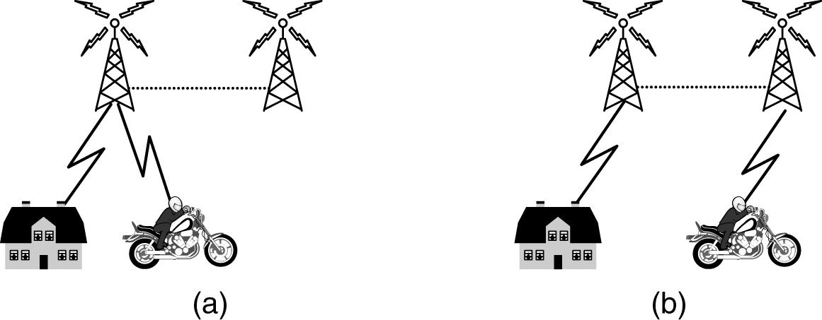
Mobile Networks (2 of 6)
When a user moves out of the range of one cellular base station and into the range of another one, the flow of data must be re-routed from the old to the new cell base station.
Notes:
Hand over handoff
Soft handover
it is possible to connect to the new
base station before disconnecting from the old base station. This
improves the connection quality for the mobile because there is no
break in service; the mobile is actually connected to two base stations
for a short while. This way of doing a handover is called a soft
handover
Hard handover
the mobile disconnects from the old base station before connecting to the new
one.

Slide 39
Mobile Networks (3 of 6)
Packet switching comes from the Internet community
Connectionless networks
Every packet is routed independently
If some routers go down during a session, no harm will be done as long as the system can dynamically reconfigure itself
Circuit switching comes from telephone companies
Connection-oriented networks
Caller must dial the called party’s number and wait for a connection before talking or sending data
Route maintained until call is terminated
Can support quality of service more easily

Slide 40
Mobile Networks (4 of 6)
First-generation mobile phone systems
Transmitted voice calls as continuously varying (analog) signals
AMPS (Advanced Mobile Phone System)
Second-generation (2G) mobile phone systems
Transmitted voice calls in digital form to increase capacity, improve security, and offer text messaging
GSM (Global System for Mobile communications)
Third generation (3G) offer digital voice and broadband digital data services
Spectrum scarcity led to today’s cellular network design

Slide 41
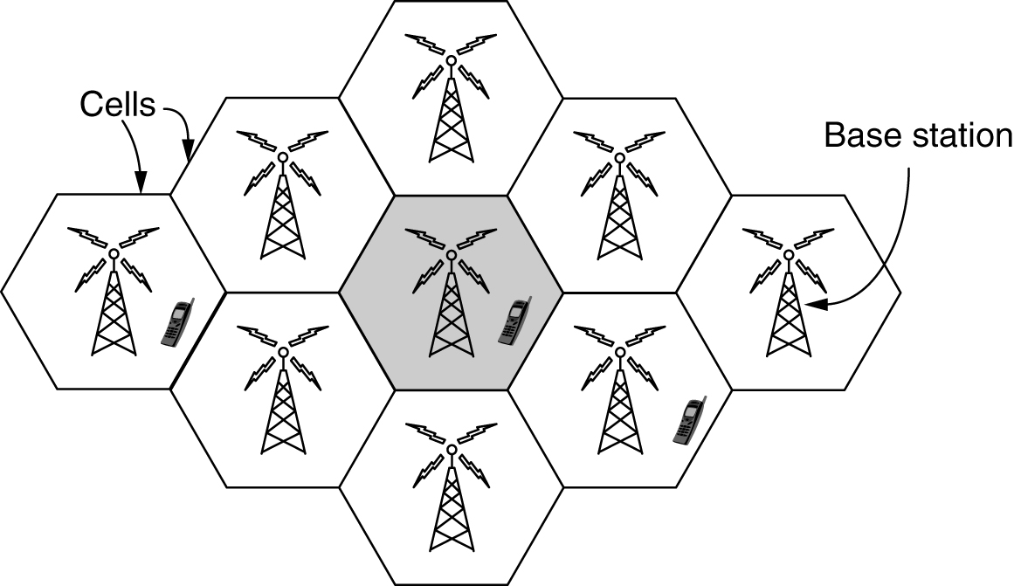
Mobile Networks (5 of 6)
To manage the radio interference between users, the coverage area is divided into cells.

Slide 42
Mobile Networks (6 of 6)
4G
Later 4G known as LTE (Long Term Evolution) technology
Offers faster speeds
Emerged in the late 2000s
Quickly became the predominant mode of mobile Internet access in the late 2000s
Outpacing competitors like 802.16 (WiMiMax)
5G technologies are promising faster speeds
Up to 10 Gbps
Set for large-scale deployment in the early 2020s
Main distinction: frequency spectrum they rely on

Slide 43
Wireless Networks (WiFi) (1 of 6)
IEEE created a wireless LAN standard
Wireless LAN standard was dubbed 802.11
Common slang name for it is WiFi
802.11 systems operate in unlicensed bands
Example: ISM (Industrial, Scientific, and Medical) bands defined by ITU-R
802.11 radios compete with cordless phones, garage door openers, and microwave ovens
802.11 network modes: Ad hoc and access point (AP)
Multipath fading causes received signals to fluctuate greatly

Slide 44
Wireless Networks (WiFi) (2 of 6)
Path diversity overcomes variable wireless conditions
Versions of 802.11
Original 802.11 ran at either 1 Mbps or 2 Mbps
802.11b used spread spectrum for rates up to 11 Mbps
802.11a/g rates were boosted to 54 mbps using OFDM (Orthogonal Frequency Division Multiplexing) modulation
802.11ac can run at 3.5 Gbps
802.11ad can run at 7 Gbps (only indoors within a single room)
CSMA (Carrier Sense Multiple Access) scheme
Handles transmission collision

Slide 45
Wireless Networks (WiFi) (3 of 6)
802.11 mobility
Of limited value compared to mobility in mobile phone networks
802.11 security
WEP (Wired Equivalent Privacy)
WEP replaced by WiFi Protected Access (initially called WPA)
WiFi Protected Access (WPA) replaced by WPA2 and 802.1X

Slide 46
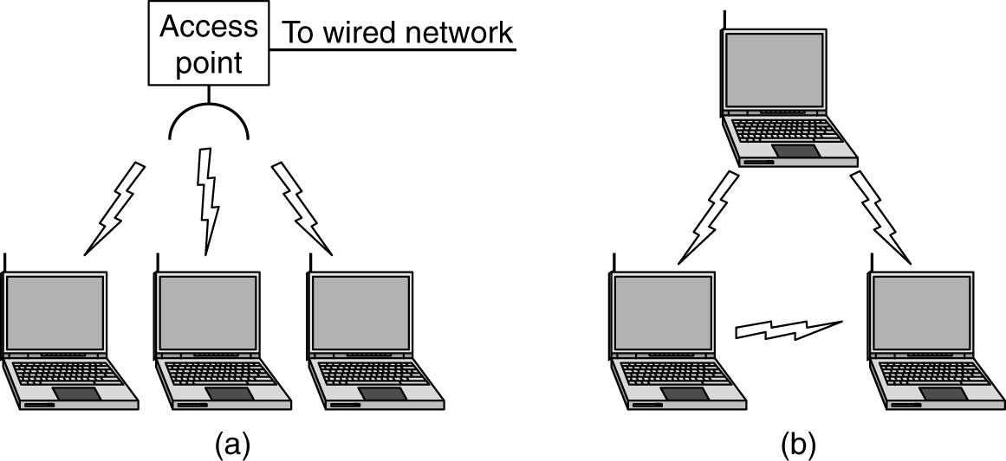
Wireless Networks (WiFi) (4 of 6)
Access points connect to the wired network, and all communication between clients goes through the access point. In an ad hoc network, clients that are in radio range talk directly without an access point.

Slide 47
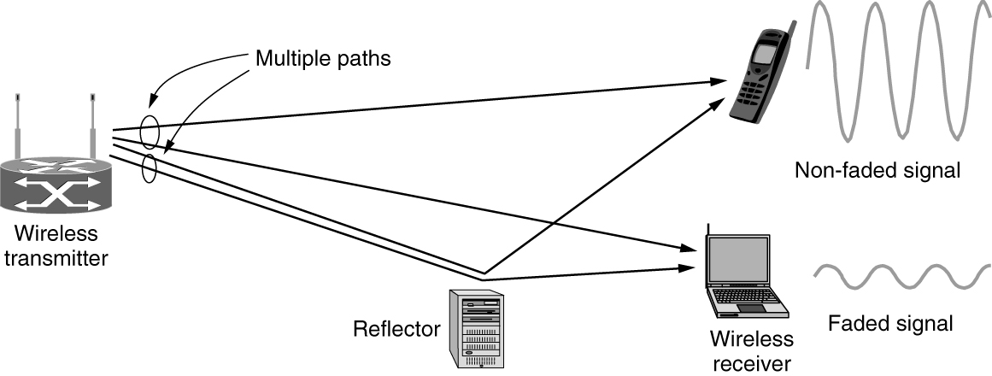
Wireless Networks (WiFi) (5 of 6)
At the frequencies used for 802.11, radio signals can be reflected off solid objects so that multiple echoes of a transmission may reach a receiver along different paths. The echoes can cancel or reinforce each other, causing the received signal to fluctuate greatly – a phenomenon known as multipath fading.

Slide 48
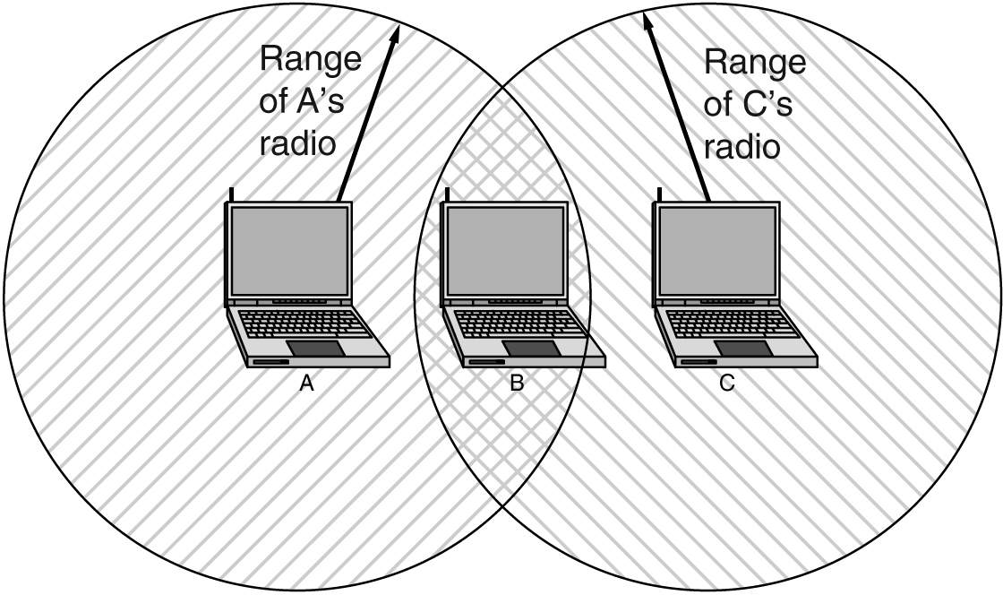
Wireless Networks (WiFi) (6 of 6)
The range of a single radio may not cover the entire system.
Notes:
The range of a single radio may not cover the entire system. Computers wait for a short random interval before transmitting and defer their transmissions if they hear that someone else is already transmitting. This scheme makes it less likely that two computers will send at the same time. It does not work as well as in the case of wired networks, though.

Slide 49
Network Protocols
Design goals
Reliability (ability to recover from errors, faults, or failures)
Resource allocation (sharing access to a common, limited resource)
Evolvability (allowing for incremental deployment of protocol improvements over time)
Security (defending the network against various types of attacks)
Network protocol design: layering
Connection-oriented vs. connectionless service
Specific service primitives

Slide 50
Design Goals (1 of 4)
Reliability
Make a network operate correctly even though it is comprised of a collection of components that are themselves unreliable
Error detection finds errors in received information
Error correction corrects a message by recovering the possibly incorrect bits
Find a working path through a network using routing
Routing allows network to automatically make the decision

Slide 51
Design Goals (2 of 4)
Resource allocation
Scalable designs continue to work well when network gets large
Statistical multiplexing: sharing based on the statistics of demand
An allocation problem that occurs at every level
Keeping a fast sender from swamping a slow receiver with data
Use flow control
Congestion problem
Occurs when too many computers want to send too much traffic, and the network cannot deliver it all
Quality of service reconciles competing demands

Slide 52
Design Goals (3 of 4)
Evolvability
Design issue concerns the evolution of the network
Over time, networks grow larger and new designs emerge that need to be connected to the existing network
Use protocol layering structuring mechanism to support change by dividing the overall problem and hiding implementation details
Use addressing or naming mechanism to identify the senders and receivers involved in a particular message
Different network technologies often have different limitations
Overall topic is called internetworking

Slide 53
Design Goals (4 of 4)
Security
Confidentiality mechanisms defend against eavesdropping on communications
Authentication mechanisms prevent someone from impersonating someone else
Integrity mechanisms prevent surreptitious changes to messages

Slide 54
Protocol Layering (1 of 4)
Networks organized as a stack of layers or levels
Each layer built upon the one below it
Communication between corresponding layers
Use a common protocol referred to as a “layer n protocol”
Below layer 1 is the physical medium through which actual communication occurs
Interface lies between each pair of adjacent layers
Network architecture: a set of layers and protocols
Protocol stack: a list of the protocols used by a certain system, one protocol per layer

Slide 55
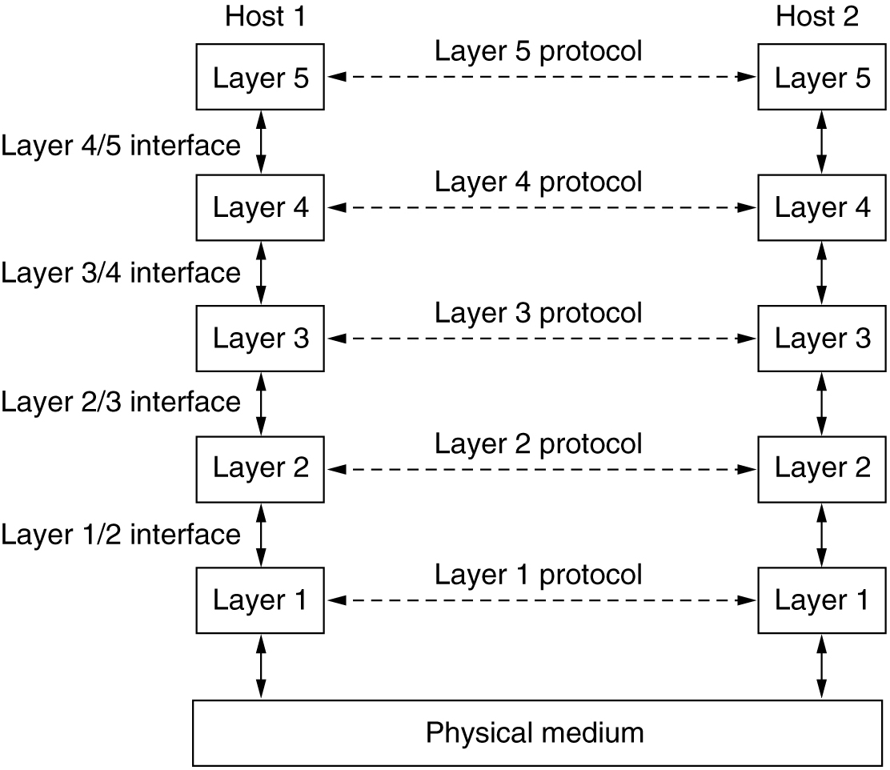
Protocol Layering (2 of 4)
A five-layer network where the entities comprising the corresponding layers on different machines are called peers.
Notes:
The peers may be software processes, hardware devices, or even human beings. It is the peers that communicate by using the protocol to talk to each other.

Slide 56
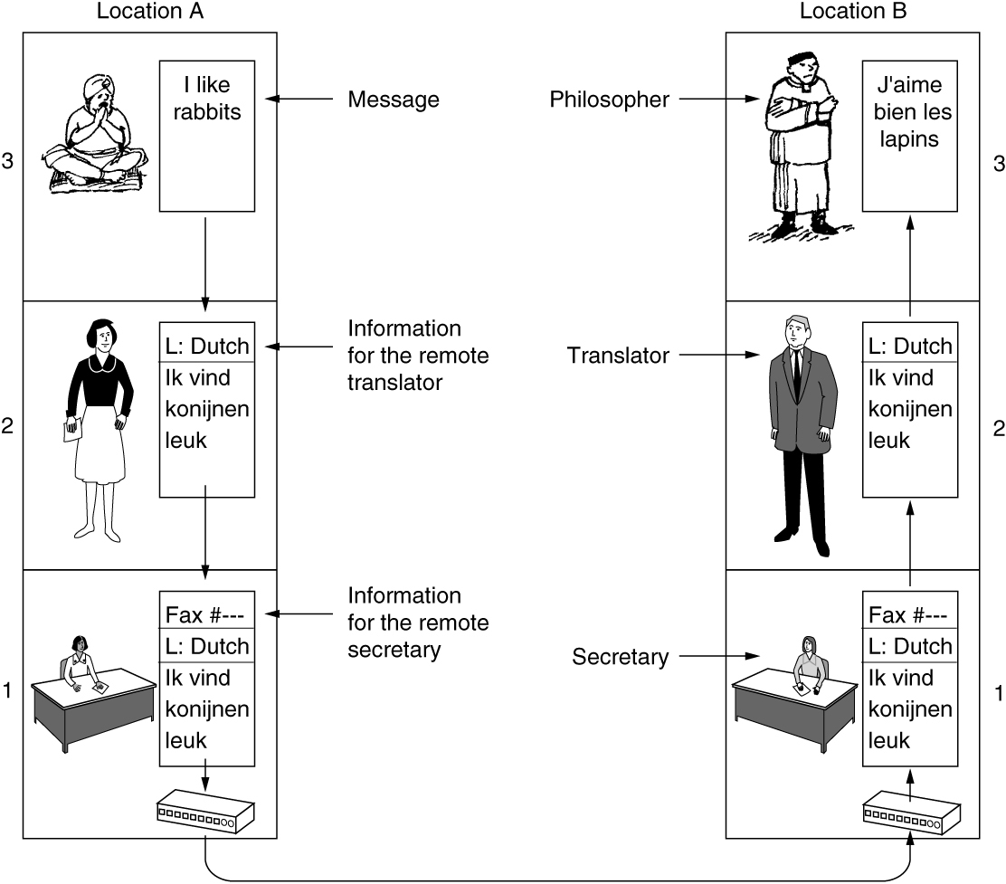
Protocol Layering (3 of 4)
The philosopher-translator-secretary architecture. This figure provides an analogy to explain the idea of multilayer communication.

Slide 57
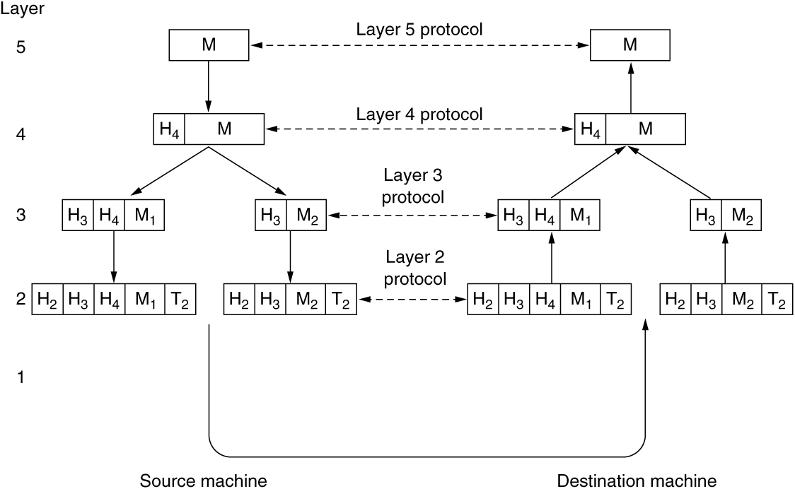
Protocol Layering (4 of 4)
An example of information flow supporting virtual communication in layer 5.
Notes:
The important thing to understand about Fig. 1-27 is the relation between the virtual and actual communication and the difference between protocols and interfaces.

Slide 58
Connections and Reliability (1 of 4)
Connection-oriented service
Modeled after the telephone system
Service user first establishes a connection, uses the connection, and then releases the connection
Can conduct a negotiation about the parameters to be used

Slide 59
Connections and Reliability (2 of 4)
Connectionless service
Modeled after the postal system
Packet is a message at the network layer
Store-and-forward switching: intermediate nodes receive a message in full before sending it on to the next node
Cut-through switching: transmission of a message at a node starts before it is completely received by the node
Datagram service: Unreliable (not acknowledged) connectionless service
Reliability characterizes connection-oriented and connectionless services

Slide 60
Connections and Reliability (3 of 4)
Connection-oriented systems
Reliable message stream (sequence of pages)
Reliable byte stream (movie download)
Unreliable connection (voice over IP)
Connectionless systems
Reliable message stream (electronic junk mail)
Reliable byte stream (text messaging)
Unreliable connection (database query)

Slide 61
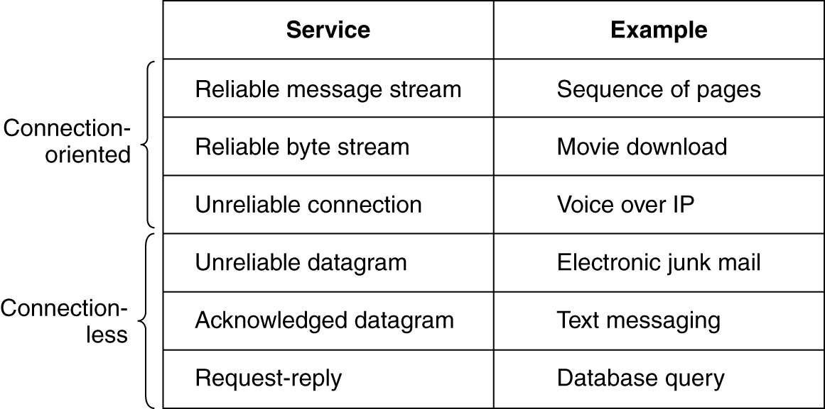
Connections and Reliability (4 of 4)
Six common connection-oriented and connectionless services.

Slide 62
Service Primitives (1 of 4)
Service
Formally specified by a set of primitives (operations) available to user processes to access the service
Primitives tell the service to perform some action or report on an action taken by a peer entity
Six core primitives
Listen (block waiting for an incoming connection)
Connect (establish a connection with a waiting peer)
Accept (accept an incoming connection from a peer)
Receive (block waiting for an incoming message)
Send (send a message to the peer)
Disconnect (terminate a connection)

Slide 63
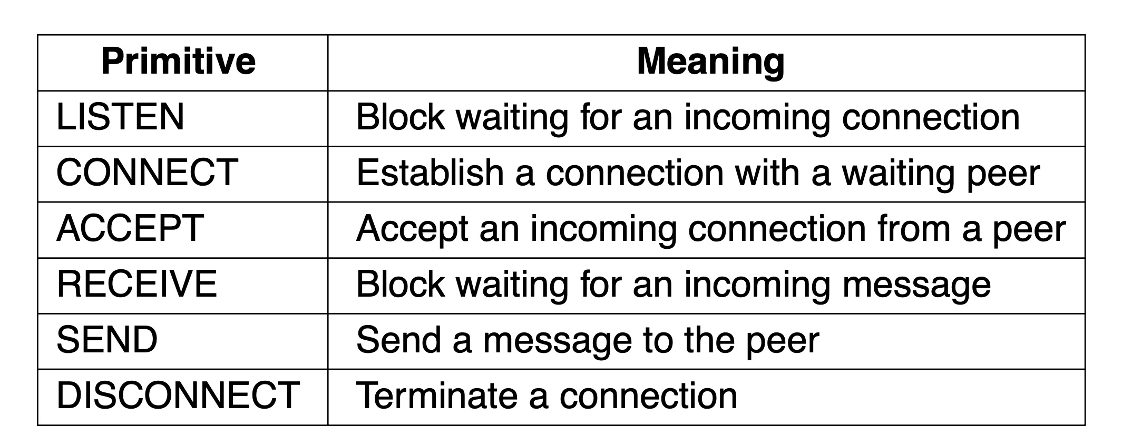
Service Primitives (2 of 4)
A minimal example of the service primitives that might provide a reliable byte stream.

Slide 64
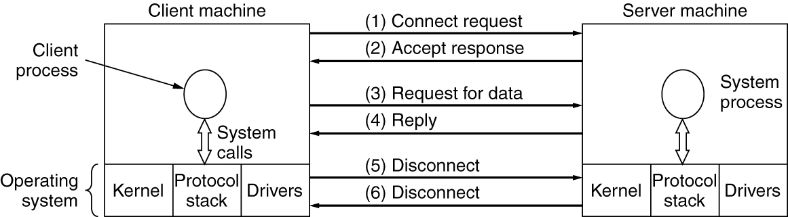
Service Primitives (3 of 4)
Figure 1-30 briefly summarizes how client-server communication might work with acknowledged datagrams so that we can ignore lost packets.

Slide 65
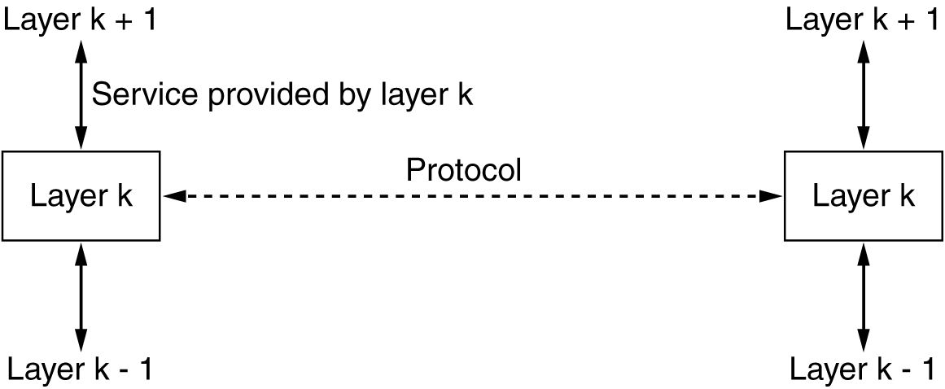
Service Primitives (4 of 4)
Entities use protocols in order to implement their service definitions.
Notes:
A service is a set of primitives (operations) that a layer provides to the layer above it.
A protocol, in contrast, is a set of rules governing the format and meaning of the packets, or messages that are exchanged by the peer entities within a layer.

Slide 66
Reference Models
The OSI Reference Model
The TCP/IP Reference Model
The Link Layer
The Internet Layer
The Transport Layer
The Application Layer
A critique of the OSI model and protocols
Critique of the TCP/IP reference model and protocols
The model used in this book

Slide 67
The OSI Reference Model (1 of 2)
Principles for the seven layers
Layers created for different abstractions
Each layer performs well-defined function
Function of layer chosen with definition of international standard protocols in mind
Minimize information flow across interfaces between boundaries
Number of layers should be optimum
Three concepts central to the OSI model:
Services
Interfaces
Protocols

Slide 68
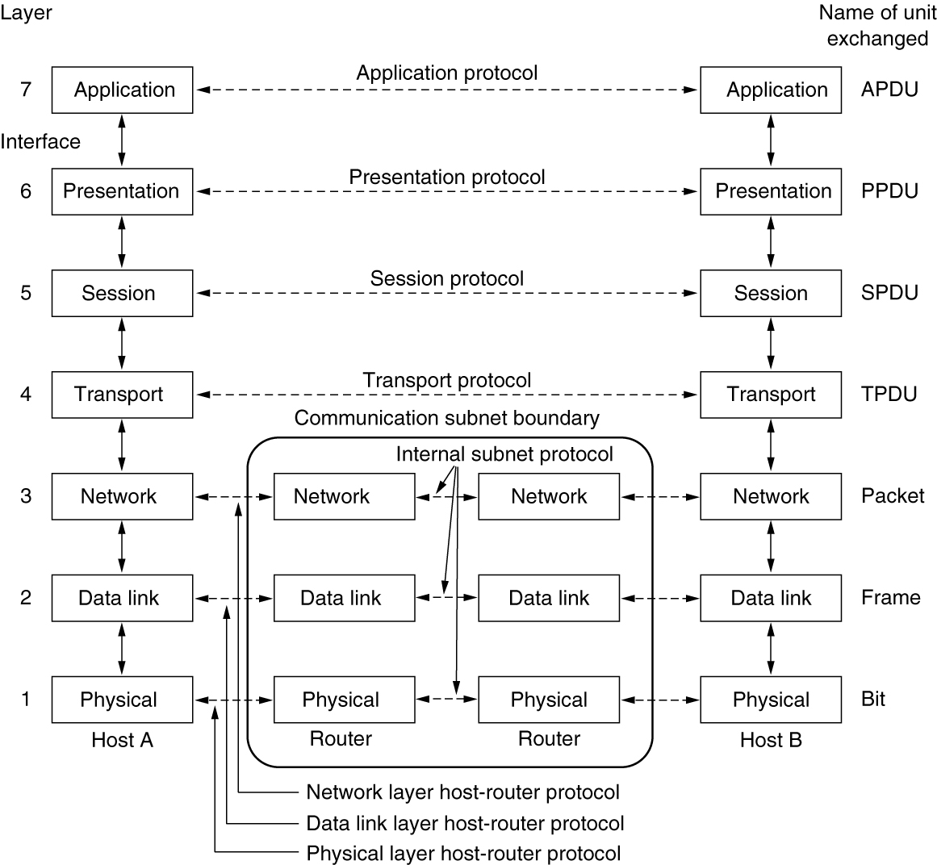
The OSI Reference Model (2 of 2)
The OSI model has seven layers.

Slide 69
The TCP/IP Reference Model (1 of 4)
The Link Layer
Lowest layer in the model
Describes what links must do to meet the needs of this connectionless internet layer
The Internet Layer
Permits hosts to inject packets into any network and have them travel independently to the destination
Defines an official packet format and protocol called IP (Internet Protocol)
Defines a companion protocol called ICMP (Internet Control Message Protocol) that helps IP function

Slide 70
The TCP/IP Reference Model (2 of 4)
The Transport Layer
The layer above the internet layer in the TCP/IP model
Uses two end-to-end transport protocols
TCP (Transmission Control Protocol)
UDP (User Datagram Protocol)
The Application Layer
Contains all the higher-level protocols

Slide 71
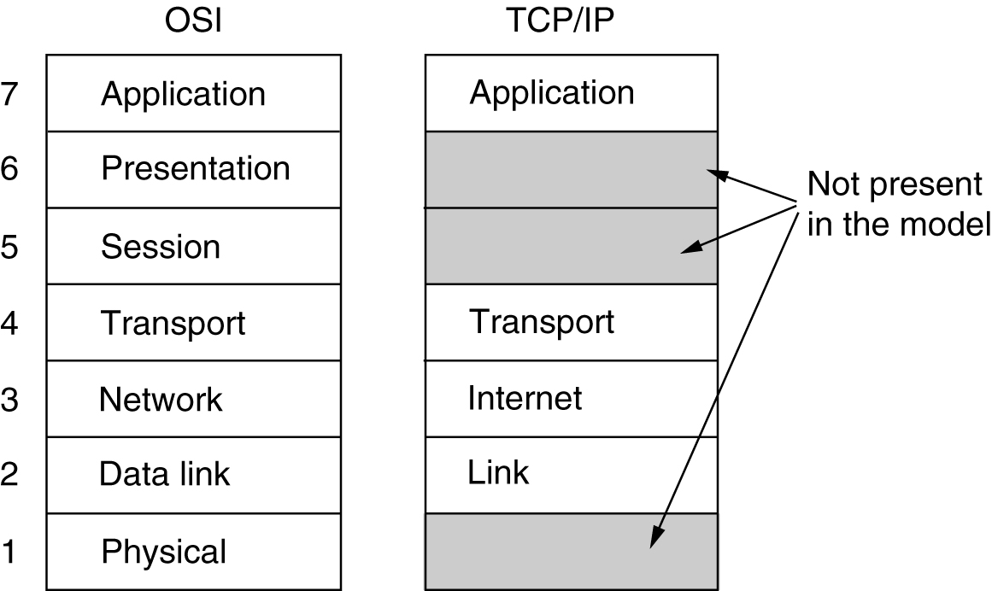
The TCP/IP Reference Model (3 of 4)
The TCP/IP layers loosely align with the OSI model.

Slide 72
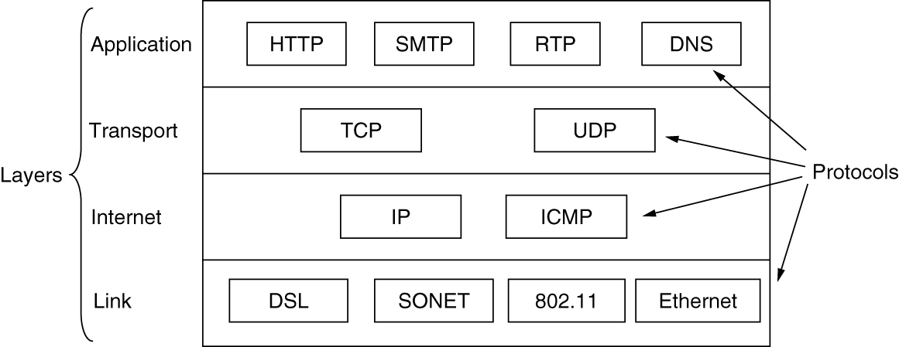
The TCP/IP Reference Model (4 of 4)
The relation of IP, TCP, and UDP protocols are illustrated. We will study these.

Slide 73
A Critique of the OSI Model and Protocols (1 of 2)
Bad timing
Competing TCP/IP protocols were already in widespread use
Bad design
Both the model and the protocols are flawed
Bad implementations
Initial implementations were huge, unwieldy, and slow
Bad politics
Widely thought to be the creature of the European telecommunication ministries, the European Community, and later the U.S. Government

Slide 74
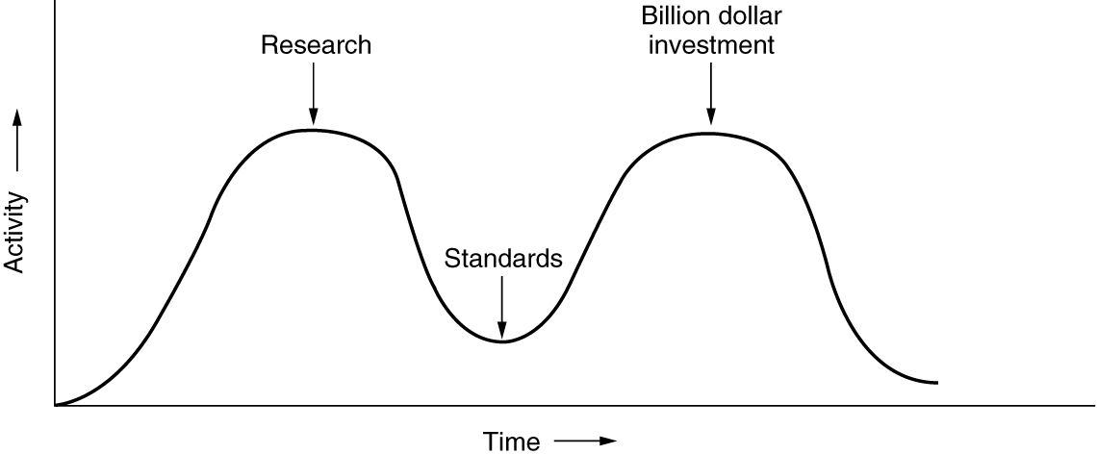
A Critique of the OSI Model and Protocols (2 of 2)
To prevent bad timing, it is essential that the standards be written in the trough in between the tops of the waves known as the two ‘‘elephants."
Notes:
It is essential that the standards be written in the trough in between the two ‘‘elephants.’’ If they are written too early (before the research results are well established), the subject may still be poorly understood; the result is a bad standard. If they are written too late, so many companies may have already made major investments in different ways of doing things that the standards are effectively ignored. If the interval between the two elephants is very short (because everyone is in a hurry to get started), the people developing the standards may get crushed.

Slide 75
A Critique of the TCP/IP Reference Model and Protocols
Model does not clearly distinguish the concepts of services, interfaces, and protocols
Model is not at all general
Poorly suited to describing any other protocol stack
The link layer is not really a layer at all in the normal sense of the term
Model does not distinguish between the physical and data link layers
Other protocol implementations were distributed free

Slide 76
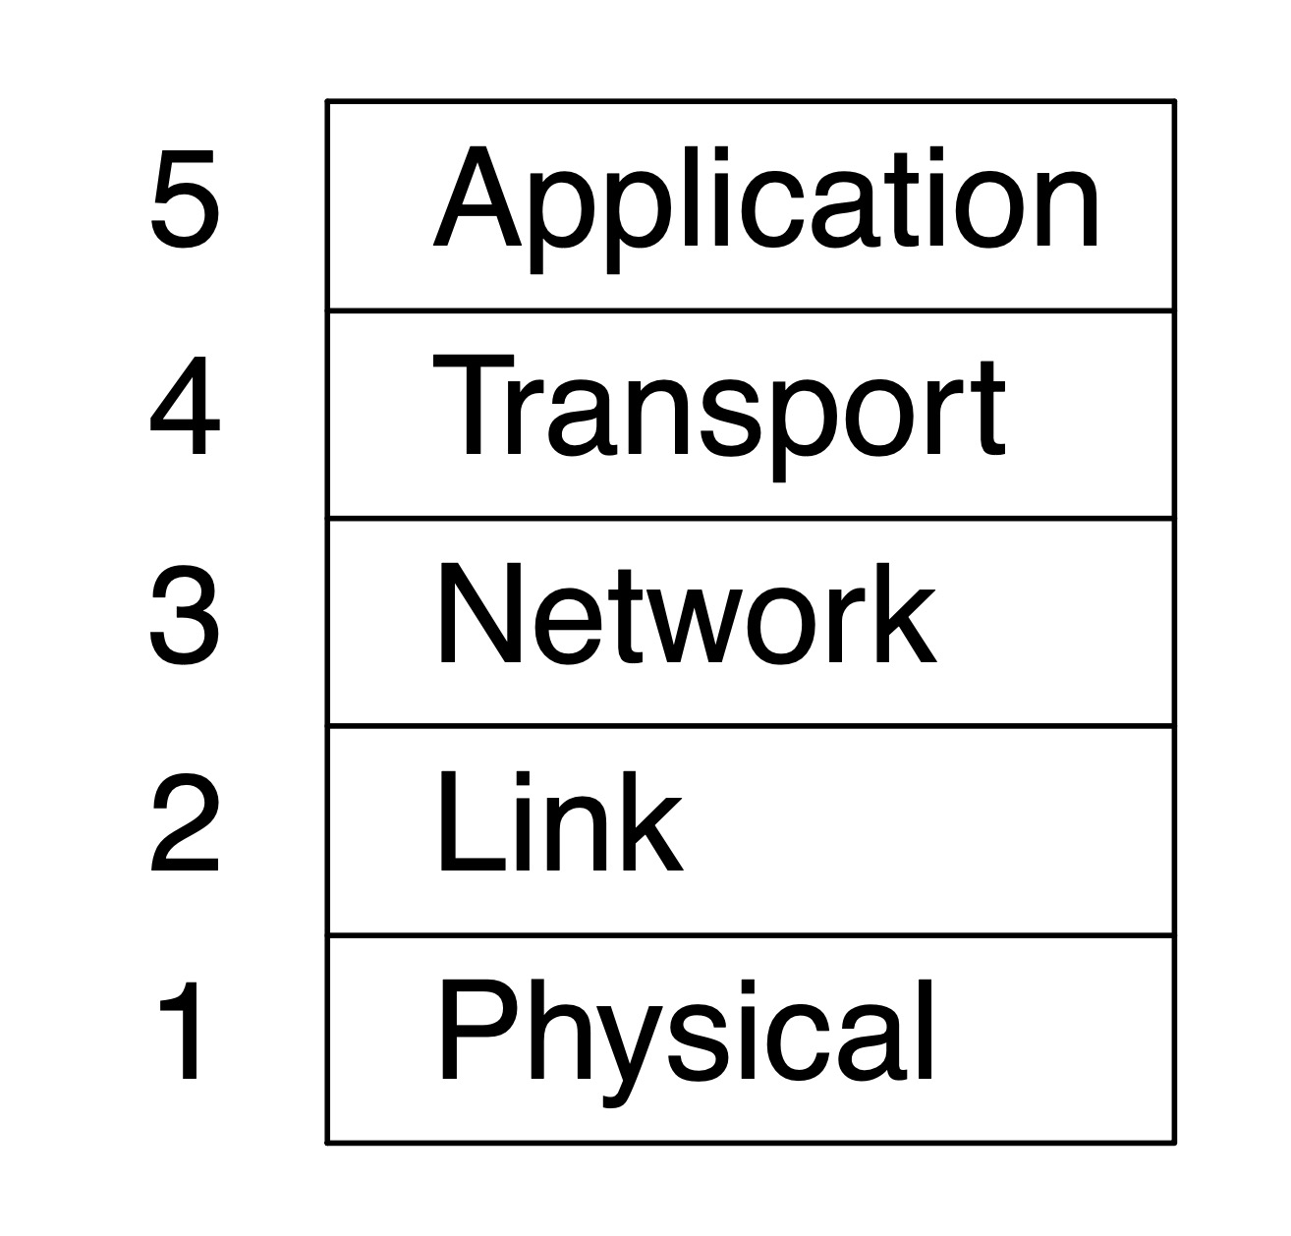
The Model Used in This Book
This model has five layers, running from the physical layer up through the link, network and transport layers to the application layer.

Slide 77
Standardization
Standardization and open source
Who’s who in the telecommunications world
Who’s who in the international standards world
Who’s who in the Internet standards world

Slide 78
Standardization and Open Source
Standards define what is needed for interoperability
No more, no less
WiFi Alliance
Interoperability within the 802.11 standard
ONF (Open Networking Foundation)
Interoperability of protocols to control programmable network switches
Two categories of standards
De facto standards just happened, without any formal plan
De jure standards are adopted through the rules of some formal standardization body

Slide 79
Who’s Who in the Telecommunications World
Two extremes
Small privately owned telephone companies
National government has a complete legal monopoly on all communication
PTT (Post, Telegraph & Telephone administration)
Branch of government having telecommunication authority
ITU (International Telecommunication Union)
United Nations agency
ITU-T: Telecommunications Standardization Sector

Slide 80
Who’s Who in the International Standards World (1 of 2)
ISO (International Standards Organization)
Publishes and produces international standards
NIST (National Institute of Standards and Technology)
Part of the U.S. Department of Commerce
IEEE (Institute of Electrical and Electronics Engineers)
The largest professional organization in the world
IEEE’s 802 committee has standardized many kinds of LANs

Slide 81
Who’s Who in the International Standards World (2 of 2)
The important ones are marked with *. The ones marked with † gave up and stopped.

Slide 82
Who’s Who in the Internet Standards World
IAB (Internet Activities Board) oversaw ARPANET
Renamed Internet Architecture Board
Communicated with RFCs (Request For Comments)
IRTF (Internet Research Task Force) subsidiary to IAB
IETF (Internet Engineering Task Force) subsidiary to IAB
More formal standardization process was adopted
Internet Society
Created, populated by people interested in the Internet
World Wide Web Consortium (W3C)
Develops protocols and guidelines to facilitate long-term growth of the Web

Slide 83
Policy, Legal, and Social Issues (1 of 3)
Online speech
Communications Decency Act protects some platforms from federal criminal prosecution
DMCA takedown notices (after the Digital Millennium Copyright Act) threaten legal action
Net neutrality
ISPs should provide equal quality of service to a given type of application traffic, regardless of who is sending that content
No blocking, no throttling, no paid prioritization, transparency
Does not prevent an ISP from prioritizing any traffic
Zero rating: ISP might charge its subscribers according to data usage but grant an exemption for a particular service

Slide 84
Policy, Legal, and Social Issues (2 of 3)
Security
DDoS (Distributed Denial of Service) attack
Botnets
Spam email
Phishing
Privacy
Profiling and tracking users by collecting data about their network behavior over time
Storing cookies in Web browser
Browser fingerprinting
Mobile services location privacy

Slide 85
Policy, Legal, and Social Issues (3 of 3)
Disinformation
Ill-considered, misleading, or downright wrong information
Fake news
Challenges
How does one define disinformation in the first place?
Can disinformation be reliably detected?
What should a network or platform operator do about it once it is detected?

Slide 86
Metric Units
The principal metric prefixes.

